Slide 1
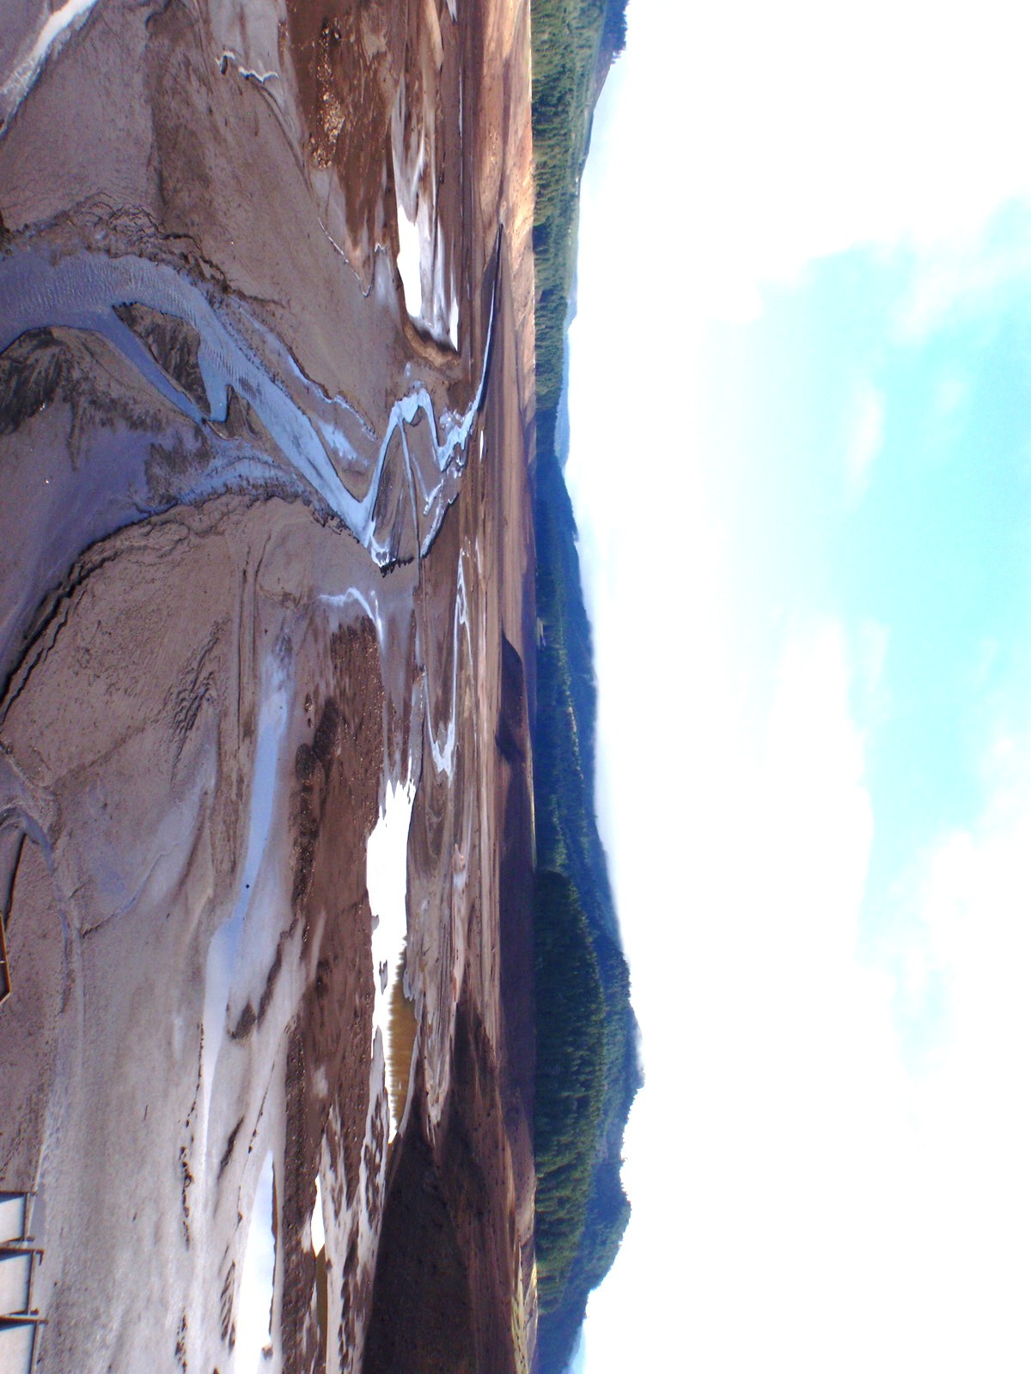

Fall Creek Overview:
Adult Returns and Juvenile Outmigration Data
Greg Taylor, Doug Garletts, Chad Helms, Todd Pierce, Jane Dalgliesh, Terri Berling, and Katie Rayfield
U.S. Army Corps of Engineers
Portland District
Willamette Valley Project

Slide 2
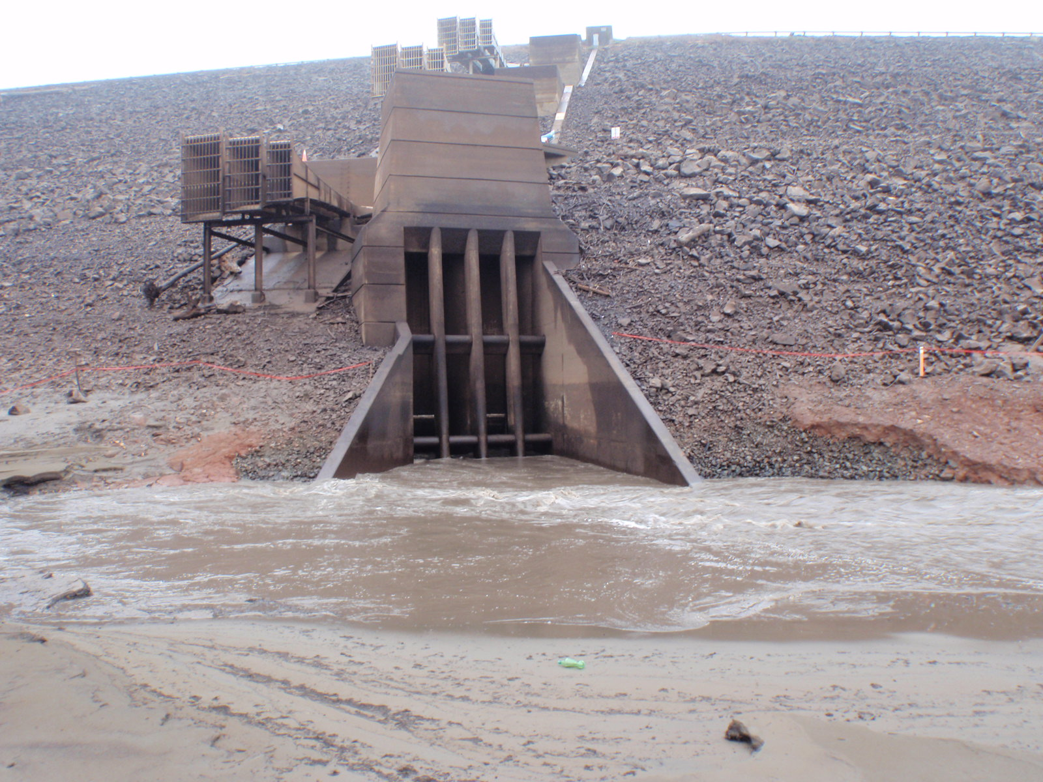
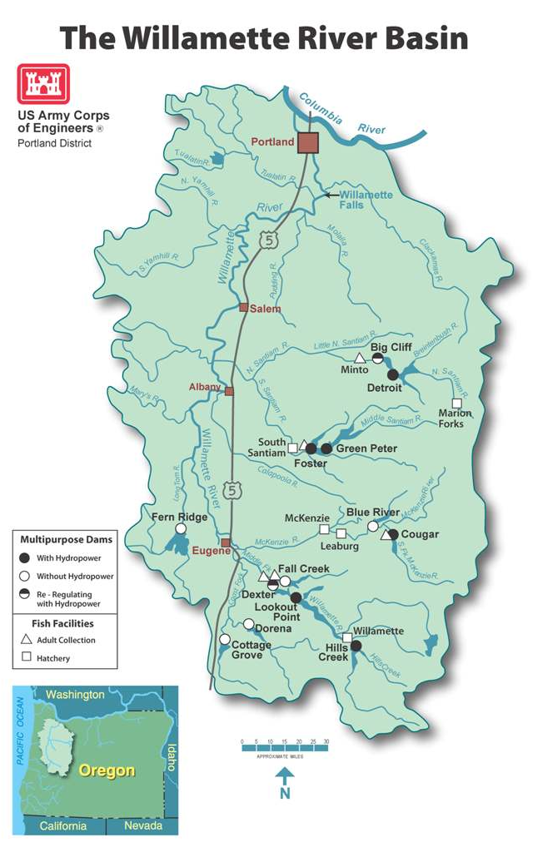
Fall Creek Dam
Dam
  Completed in 1966
  5,100 ft. long
  180 ft. high
Reservoir
  6.8 miles
  Min. Conservation Pool (728’): Dec – Jan
  Refill: Feb - mid May
  Drawdown: Sep – Nov
  Water released from horns, Ro
  Fish passage through horns poor

Slide 3
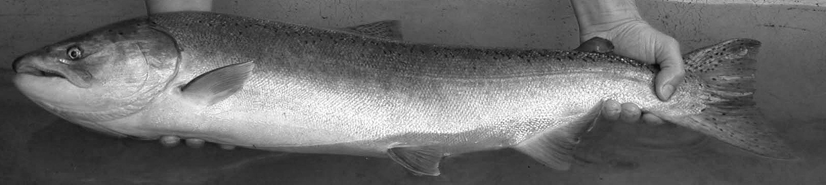
FALL CREEK HISTORICAL CHS RETURN
USFWS estimated 600 chinook spawned historically in Fall Creek (U.S. Fish and Wildlife Service, 1962)
450 above the Fall Creek Dam

Slide 4
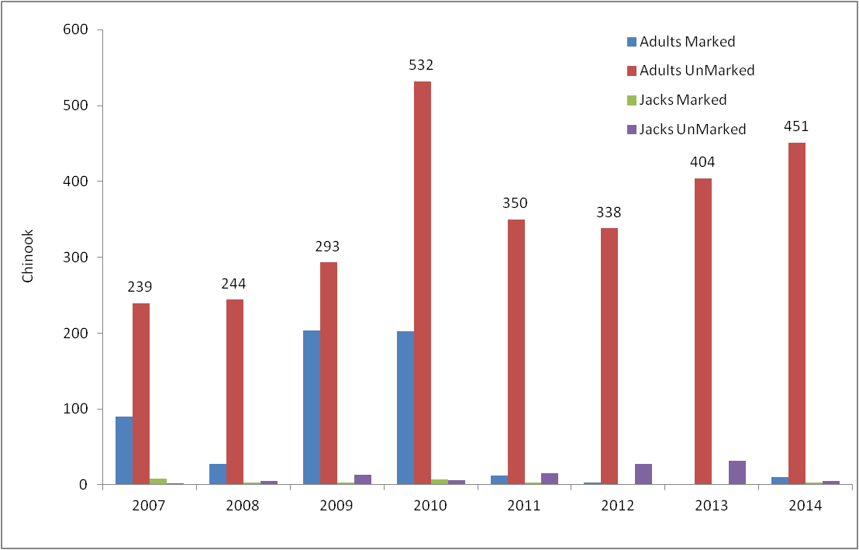
ADULT CHS RETURNS

Slide 5
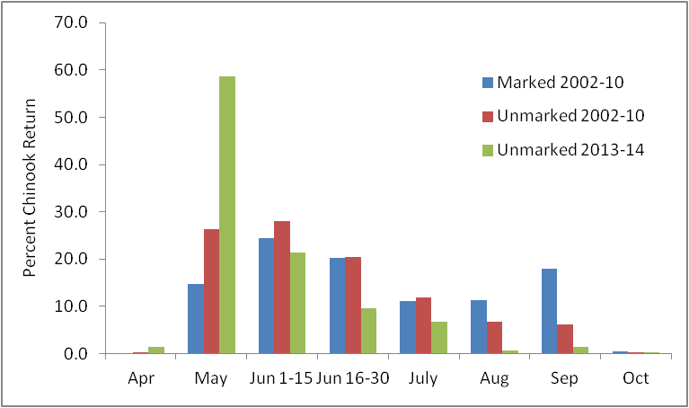
Migration Timing

Slide 6
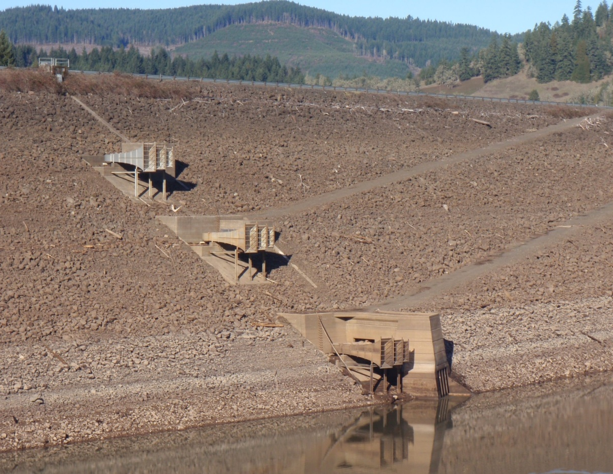
Evaluator / Fish Horn Operations
Fish Horns (Upper/Middle)
2013
March 19th – October 15th
  211 days
2014
March 18th – October 16th
  213 days
Fish Horn Trap (Evaluator)
2013
May 21st – October 15th
  148 days (70.1%)
    Missed 63 days (Spring)
2014
March 18th – October 16th
  210 days (99%)
    Missed 3 days
    (Aug. 25-28 cleaning)
800’
765’
720’
680’

Slide 7
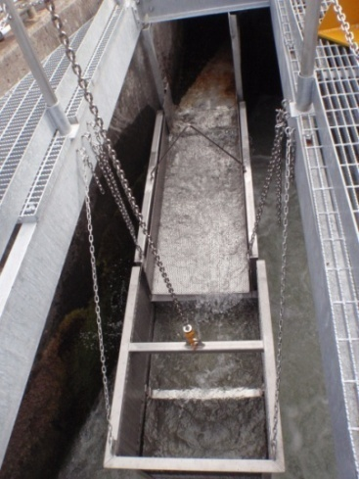
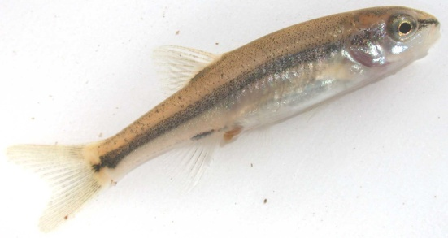
Evaluator Catch
Non-Natives
Bluegill (n=740)
Bullhead (n=348)
Largemouth Bass (n=18)
Natives
            Chinook (NM n=154, AD n=39)
            Rainbow (NM n=82, AD n=7)
            Lamprey (n=26)
            Cutthroat (n=7)
Crappie (n=1)
Dace (n=16)

Slide 8
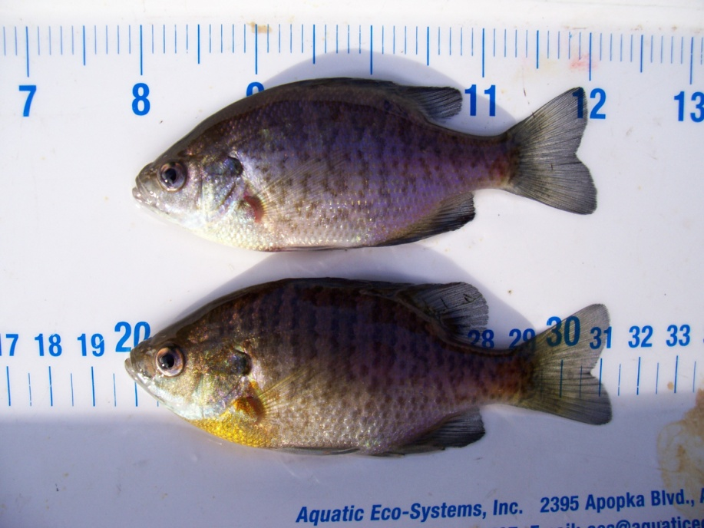
Evaluator Catch Composition
 | 2013 | 2014
UnMarked Chinook | 164 | 154
Hatchery Origin Fish | 11 | 46
Native | 72 | 135
Non-Native | 781 | 1107
Total Catch | 1028 | 1442

Slide 9
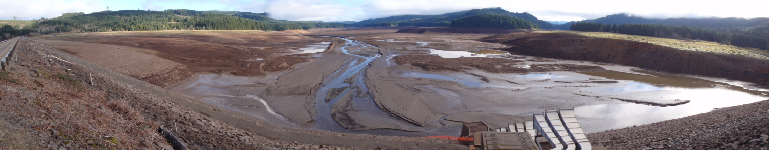
Evaluator Migration Timing 2014
Spring
May- June (61%)
Max. Con. Pool (830’)
Fall
Late Sep./ Oct.
Prior to drawdown

Slide 10
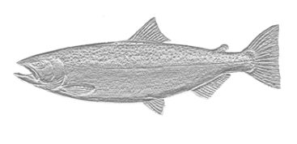
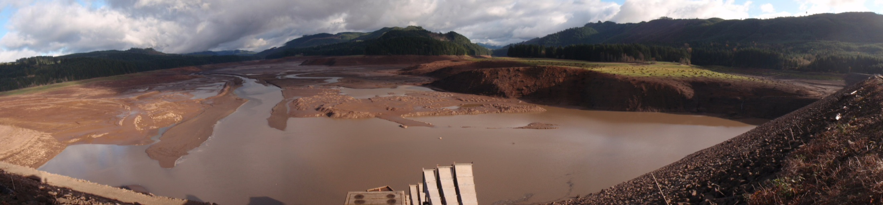
Fall Creek Drawdown Biological Objectives
Increased fish passage efficiency
Increased fish passage survival
Reduced predation and competition for rearing juvenile Chinook salmon

Slide 11
Reservoir Elevation 2012-15
Adaptive Management
Timing, Flows, etc

Slide 12

Fall Creek Drawdown 21 Nov 2014

Slide 13
2011
2012
2013
2014
Trap Off
Trap Off
Min. Con. Pool (728’)
Min. Con. Pool (728’)
Notes:
Note different scale on secondary vertical axis’s

Slide 14
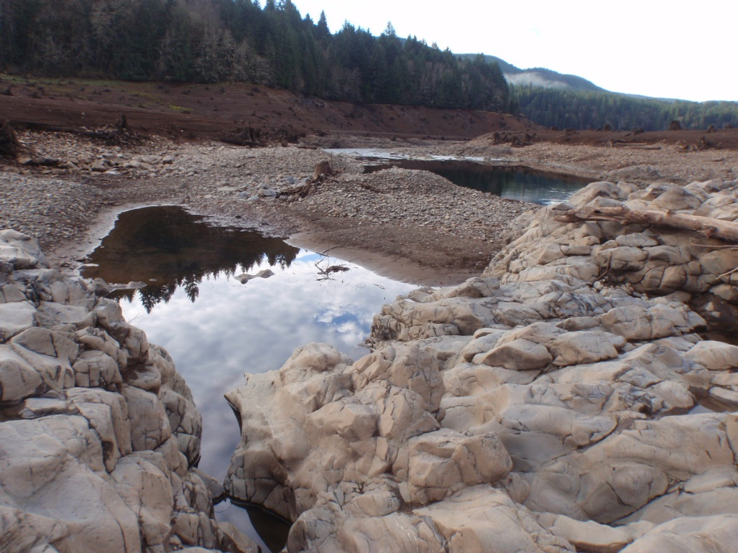
Mean Screw Trap Fork Length Sep.- Jan.

Slide 15
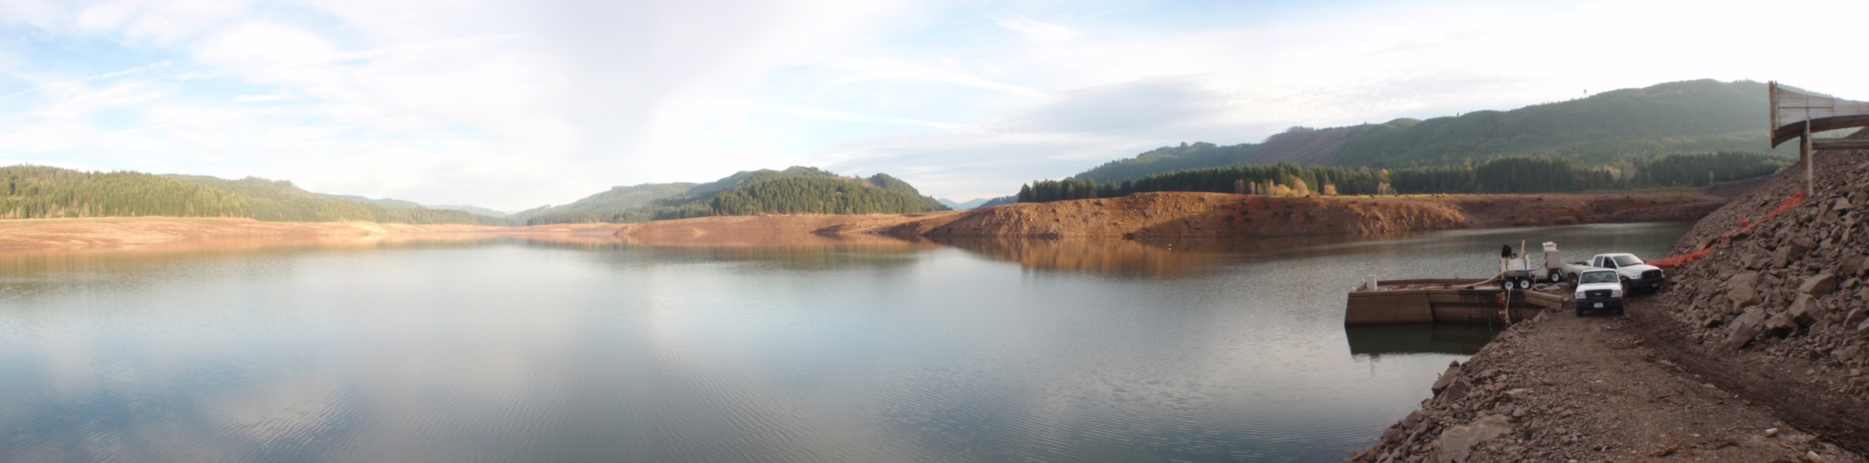
Screw Trap Efficiency Tests
2011-12
2013-14
2009-10

Slide 16
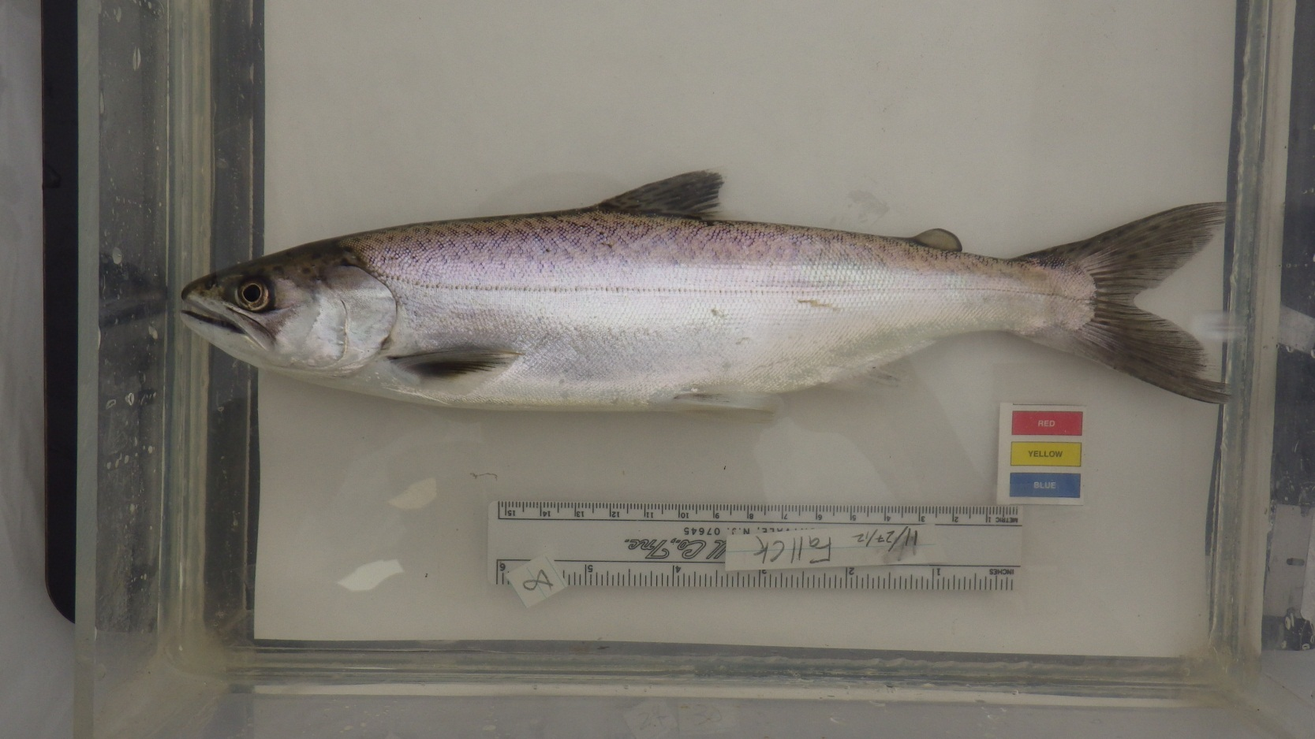
Chinook Population Estimates
Year | N | Low | High
2006-07 | 193 | 8,042 | 24,125
2007-08 | 166 | 6,917 | 20,750
2008-09 | 138 | 5,750 | 17,250
2009-10 | 159 | 6,625 | 19,875
2010-11 | 270 | 11,250 | 33,750
2011-12 | 398 | 9,707 | 28,429
2012-13 | 277 | 2,216 | 3,011
2013-14 | 440 | 12,222 | 13,750
2014-15 | 489 | 10,867 | 37,615

Slide 17
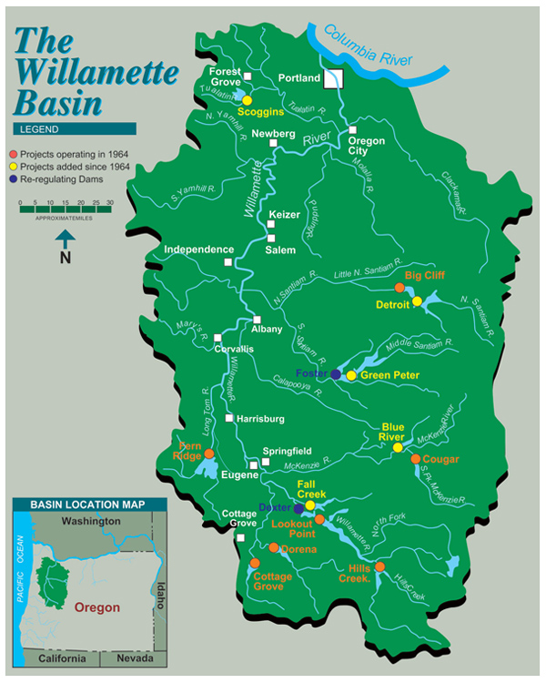
PIT Tagging
Willamette Falls Detections
2011
  6/ 311 (1.9%)
  Med travel time- 7 days
2012
  1/ 201 (0.5%)
  Med travel time- 17 days
2013
  15/ 224 (6.7%)
  Med travel time- 6 days

Slide 18
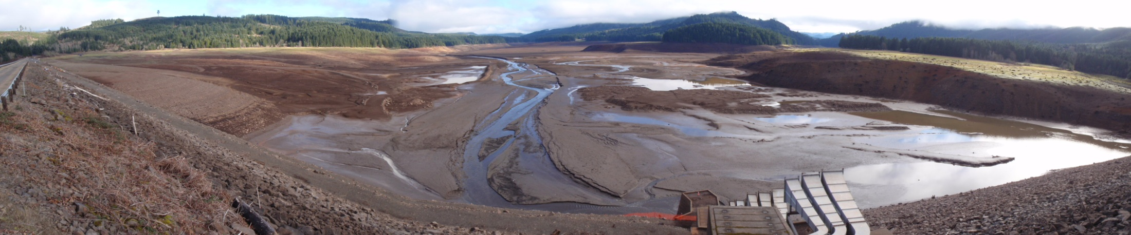
Screw Trap Species Composition

Slide 19
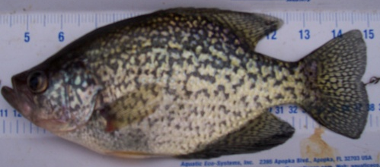
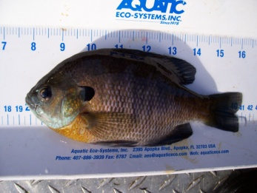
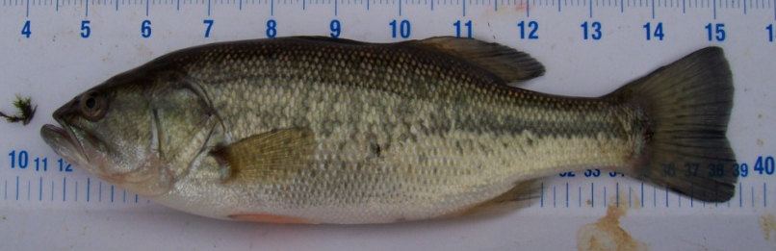
Warmwater Species
6
4
6
4
0

Slide 20
Summary
  Increased fish passage efficiency
Increased fish passage survival
Reduced predation and competition for juvenile Chinook salmon
Large quantity of sediment released downstream during drawdown
from elevation 690’ – 680’

